Slide 1

Audio Library
https://github.com/jpvanoosten/Audio
Notes:
In this presentation, you will see how you can integrate the audio library into your own projects.

Slide 2

Contents
Why?
Download the Audio Library
Generate Build Files
Build
Integrate
Use
Notes:
In this prestation, I will first describe why I wanted to make the Audio library.
I will show you how you can get the source code for the Audio library and build it yourself.
I will also show you how you can integrate the Audio library in your own project and how to use the audio library to play sound effects for your game.

Slide 3

Why?
Minimalistic Audio library
Alternative to OpenAL
Simple interface
No frills
No dependencies
Cross-platform
Built with miniaudio
Notes:
I built the Audio library as a minimalistic audio library for use in a simple game framework that is used for making simple 2D games.
When making a simple 2D game, you often don’t need a bloated audio library like OpenAL. Usually, you just want to load a sound effect or background music and play it at the right time.
Other game frameworks like SFML or SDL2 provide an audio library, but it is often difficult to use the audio subsystems from these libraries without pulling in other dependencies.
The Audio library is designed to be simple to use, but at the same time, provide a sufficient amount of functionality to be useable in both 2D and 3D games.
The Audio library is just a C++ wrapper for the miniaudio library. The Audio library provides a simpler interface than miniaudio.

Slide 4

Download
Source code is available on GitHub
Use your favourite Git client, or use the command-line
git clone https://github.com/jpvanoosten/Audio.git
https://1000logos.net/github-logo/
Notes:
To get access to the Audio library, clone the GitHub repo to your local computer using either your favourite Git client or use the command shown on the bottom of the slide to clone the repo to your local computer.

Slide 5
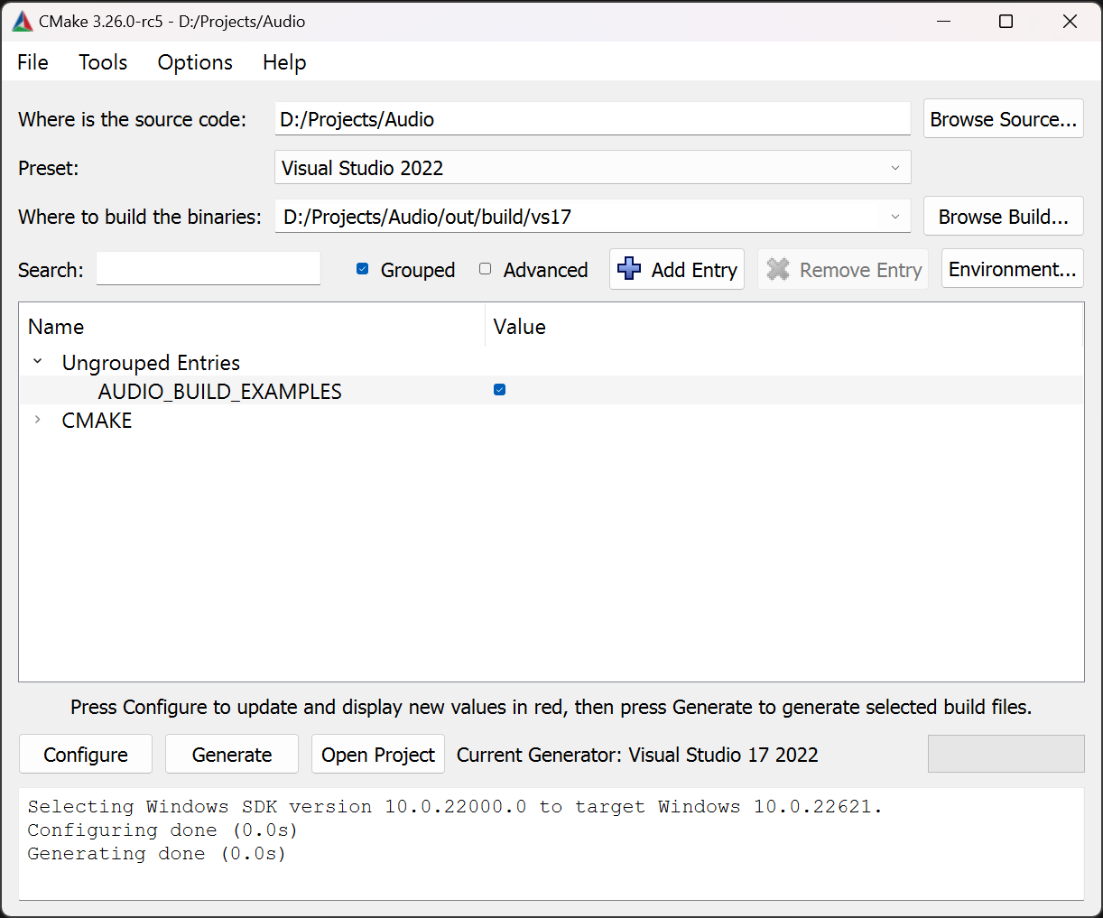
Generate Project Files
Use CMake to generate Visual Studio Project files
Use Visual Studio 2019 or Visual Studio 2022 preset in Cmake
Click Configure > Generate > Open Project
Or use the command-line
1
2
3
cmake -B build
Notes:
You can use CMake GUI to generate the solution and project files for the build toolchain you are using.
The image shown on the slide is using the Visual Studio 2022 preset to generate solution and project files for Visual Studio 2022.
Optionally, you can use the command line to generate the build files for whatever toolchain cmake detects on your system.
The command shown on the bottom of the slide should be run from the root folder of the Audio repository. The build files are placed in a folder called build.
Optionally, you can use the provided GeneratProjectFiles batch file in the project root to generate the Visual Studio solution and project files.

Slide 6
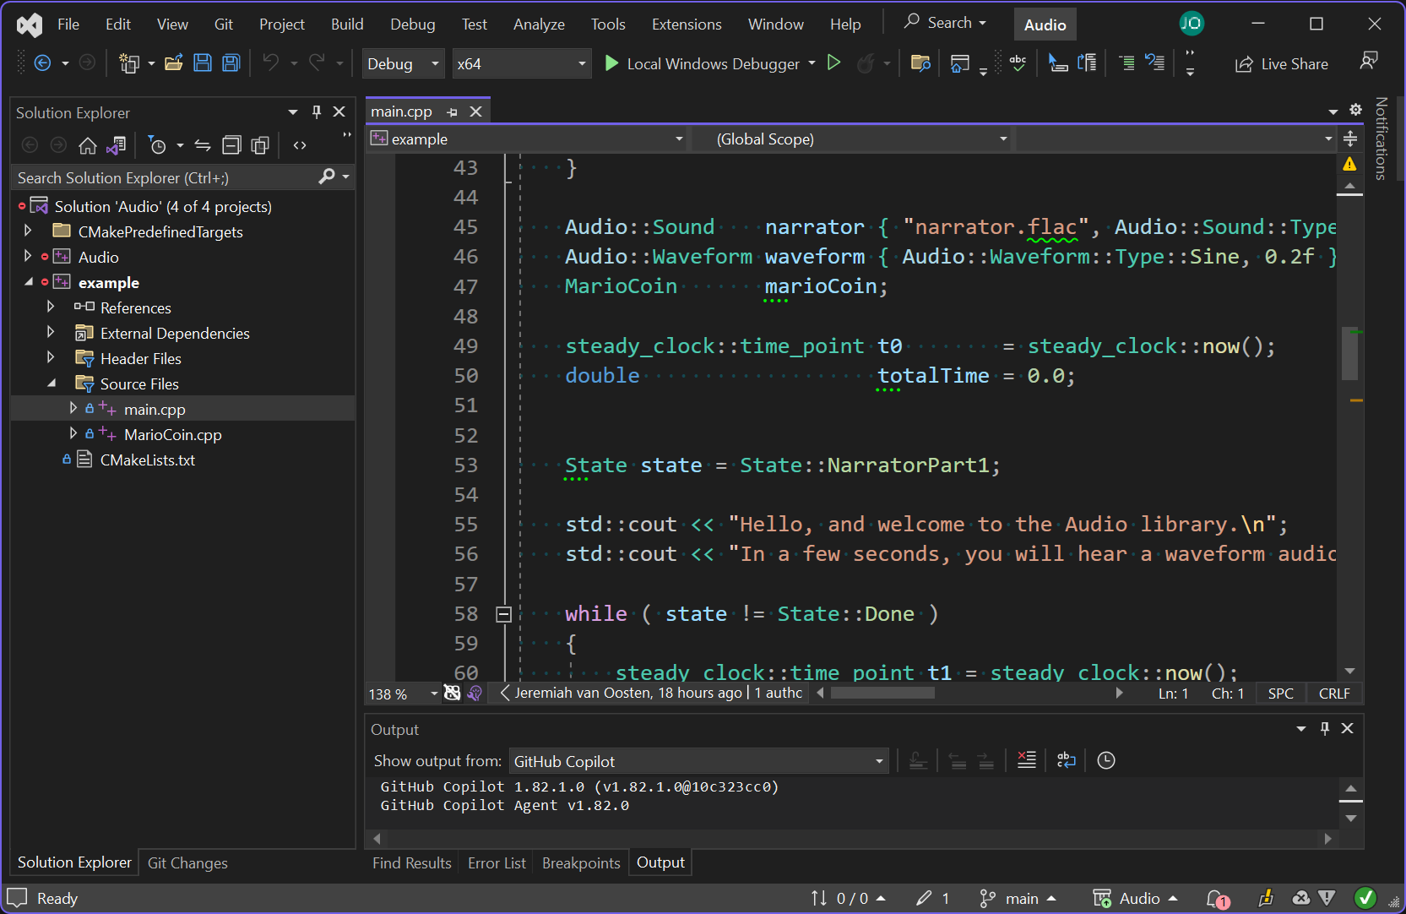
Build
Open the generated solution file in Visual Studio
Build > Build Solution (Ctrl+Shift+B)
Library files go to the lib folder
Binary files go to the bin folder
Notes:
To actually build the library, open the generated Visual Studio solution file and select Build > Build Solution from the main menu.
If everything goes okay, you should be able to run the example project in the debugger to test if it is working.
The library files should be placed in the lib folder and the binary files should be placed in the bin folder in the root of the repository.
You should be aware that the library files generated with your version of Visual Studio may not work with other versions of Visual Studio.

